Slide 1
Exploratory Analysis of Sydney’s
Best Fitness Center Location Openings
By Kristobal Esgana
Coursera Capstone Project

Slide 2
Aims
To explore the many types of fitness centers available within Sydney and which are the most thriving.
This may prove to be useful in identifying which locations and types of fitness center may be optimal to open based on popularity within that area.
The analysis and findings within this report may provide insight to those interested in opening a certain type of fitness center within Sydney’s suburbs.

Slide 3
Data acquisition and processing
Populations Data – This data is extract from the Australia Bureau of Statistics website for the latest census. Retrieved here: https://www.abs.gov.au/
Locations Data – Derived from Matthew Proctor’s open source project as retrieved from official Australia Post Retrieve here: https://www.matthewproctor.com/australian_postcodes
Foursquare Data – The data from Foursquare will be used to compile a list of the all the fitness centers within Sydney and their associated popularity along with their location and coordinates. Retrieved from within Foursquare’s API using python.

Slide 4
Clustering the datasets
The data acquired will firstly need to be processed and then combined.
Once done that data will be clustered using the k-means clustering method with up to 5 clusters for optimal clustering classification. This should then produce the clustered dataset for in-depth analysis.

Slide 5
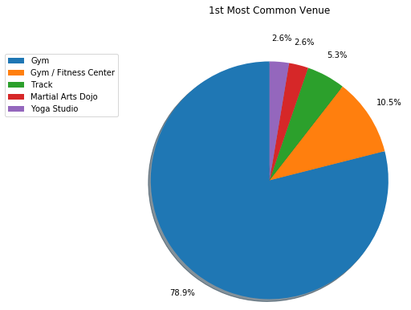
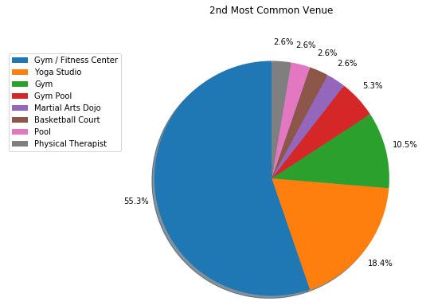
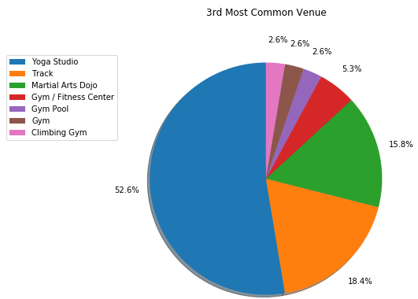
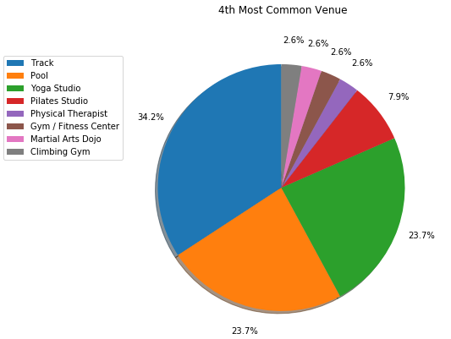
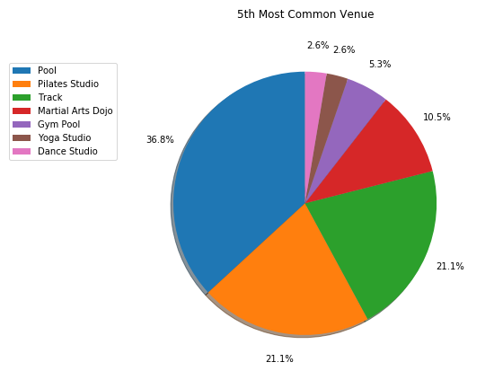
Breakdown of Most Common Venues
Within the 1st most common venues, the highest occurring are gyms/fitness centers with Both gyms/fitness centers combined having over 50% of the ratio with as gyms usually have a lot more a multi-purpose for use.
Yoga Studios, Tracks and Martial Arts Dojos are the next most common venues.
The next common venues although not as popular as the venues listed above, are pools and pilates studios.

Slide 6
Cluster Overview and Analysis
Cluster 1: primarily will have Gyms/Fitness centers and Yoga studios followed by pools, track and dojos.
Cluster 2: primarily will have Gyms, Yoga Studios and Track fitness centers are among the most common fitness
Cluster 3: will primarily have Track, Martial Arts Dojo and Yoga Studios and secondary are pools and Pilates Studio.
Cluster 4 primarily will have gym/fitness centers and yoga studios as most common venues followed by track, pools and pilates studios.
Cluster 5 will primarily have Gyms, yoga studios, pools and tracks followed by physical therapists, martial arts dojos and basketball courts

Slide 7
Top 10 populations of Sydney’s Suburban Regions
These are the top 10 populations of Sydney’s suburban regions
As shown in the analysis, Gyms/Fitness centers are still one of the most popular, followed by yoga studios. Tracks, martial arts dojo and pools also seem to be next as the next most common.

Slide 8
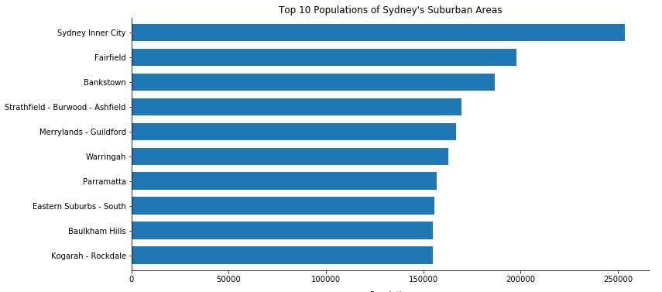
Conclusion and Recommendations
As shown in the analysis and results previously, it would be optimal to primarily open a gym, track, martial arts studio and a yoga studio within Sydney as these venues prove to be the most popular.
To increase customer attraction, open the venue in one of Sydney’s populous suburban region.
Competition may be high, but attraction will also be high due to the venue’s popularity. High risk, high reward.

